Slide 1


Slide 2


mobile charging using coin insertion

Slide 3
TEAM MEMBERS:
S.VIDHYA SHREE (927621BEC239)
S.SIVAPRIYA (927621BEC200)
P.VINOTHA (927621BEC241)
S.SHOBIKA (927621BEC198)
GUIDED BY :
MR .K.SUDHAKAR
AP/ECE

Slide 4
CONTENTS
INTRODUCTION
PROBLEM STATEMENT
OBJECTIVES
EXISTING SYSTEM
PROPOSED SYSTEM
BLOCK DIAGRAM
MODULES IDENTIFIED
REFERENCES
CONCLUSION

Slide 5
Introduction
This is the smart coin based mobile charging system that charges your mobile for particular amount of time on inserting a coin.
The system is to be used by shop owners, public places like railway stations to provide mobile charging facility.
So the system consists of a coin recognition module that recognizes valid coins and then signals the microcontroller for further action.

Slide 6
Problem statement
In today’s world, mobiles are considered as the important part of life. People tend to use its huge features, which consumes charging. Peoples who use to make every long journey may require charging anywhere. Similarly, in many developing areas where grid power is not available for few hours to several hours on regular basis, people may require electricity to charge their mobile to continue with their works. So in order to overcome all these problems Mobile Charging Based on Coin Insertion is designed. It would provide reliable charging services with less cost. This system will be very helpful.

Slide 7
OBJECTIVE
Mobile are phenomenal in recent years for communication as well as in day-to-day life. Hence, charging the e-vehicle has become the greater task.
In this paper ,we are trying to design a mobile battery charger on coin insertion.
As uses of mobile are increasing day by day it need battery life all the time, so in order to use them public charging is needed which would be useful for mobile users.

Slide 8
EXISTING SYSTEM
First LCD will display to insert the type of coin then user will insert the coin. When a coin is detected by a vending machine.
After this LCD will display select port terminal .
The Microcontroller will check for new coin if new coin is detected then it will add delay count.
When count is equal to zero the charging stops .Same procedure will be repeated when user will again enter new coin.

Slide 9
PROPOSED SYSTEM
The system uses a coin acceptor machine which will detect for a valid coin. The coin acceptor is connected to Arduino board and it then connected to the LCD display.
The relay will control the power supply to charger, after completion of time duration it will stop supplying power.
The LCD screen will show how much time left for the charging if the user wants to increase the duration of charging he needs to add another coin then the microcontroller adds the time in currently remaining time.

Slide 10
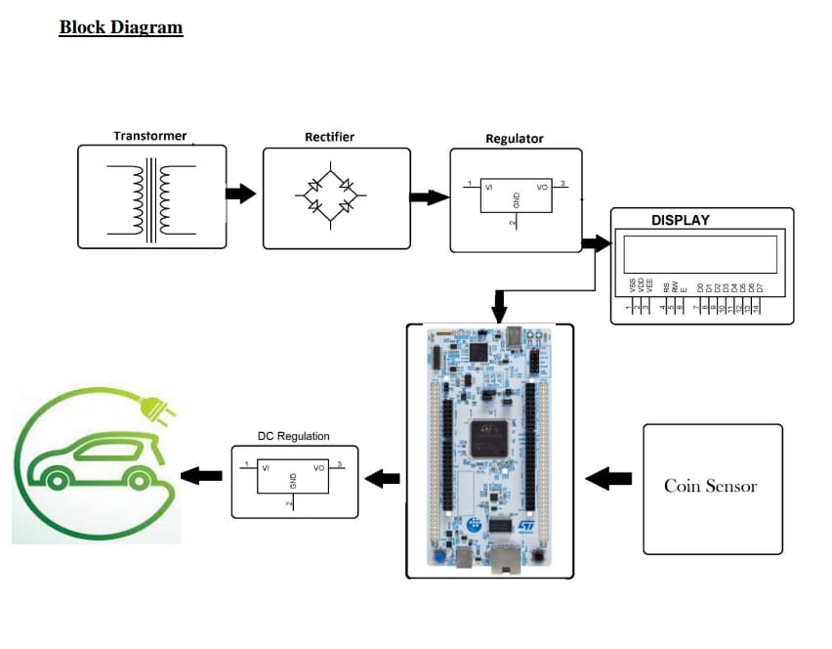
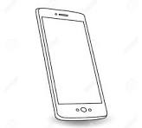

Slide 11
Modules identified
Input stage-To recognize and accept the valid coins
Controller-To control the voltage supplied
Power-To supply the power based on the requirements
Output stage-To display the output information on screen

Slide 12
REFERENCES
[1] S. Banu Prathap, R. Priyanka, G. Guna, Dr. Sujatha “coin primarily based totally mobileular telecell smartphone charger” International Journal of Engineering Research & Technology (IJERT) ISSN:2278-0181. Volume 2, Issue 3 (March 2013).
[2] M.S. Varadarajan, “Coin Based Universal Mobile Battery Charger”
[3] IOSR Journal of Engineering (IOSRJEN) ISSN:2250-3021 Volume 2,Issue 6 (June 2012).

Slide 13
CONCLUSION
In this project, a coin insertion based mobile charging system is developed which can be installed at public places.
Interfacing of various components like the coin insertion machine, LCD, 4*4 matrix keypad, servo motors with the Arduino microcontroller, and programming each of the components to function satisfactorily forms the heart of this project.
This project can also be implemented at public places with an additional benefit of displaying advertisements in order to generate revenue.

Slide 14


